Slide 1
A Framework for Benevolent Computer Worms
Rodney Beede
Master’s Thesis - University of Colorado
19 April 2012

Slide 2
Agenda
Objective of Research
Related Work
Ethical & Legal Implications
Analysis of Characteristics
Framework
Evaluation
Results
Conclusion & Future Work

Slide 3
Objective of Research
Explore legal & ethical issues
Define characteristics
For Benevolent Worms
Develop framework
Audit log
Congestion friendly
Demonstrating feasibility

Slide 4
Worms
Concept since 1949
von Neumann
Self-replicating computer program
Intent
Mostly malicious
File deletion, credentials theft, etc.
Replication
Few well meaning (benevolence)
Explored later

Slide 5




Why a Benevolent Worm?
Opinion before 2011
Too risky
Crash hospital or nuclear plant?
Unethical
No consent
Bruce Schneier
Opinion 2011+
Benefits to community outweigh risks
Bruce Schneier
Need next generation technology
Ex: Kelihos botnet
Microsoft & Kaspersky
Too risky to patch victims
Unpatched used again later

Slide 6
Related Work
Henri J. Isenberg of Symantec Corporation
Patent author: “A Benevolent Worm To Assess And Correct Computer Security Vulnerabilities”
Tied to central anti-virus server
Notified user via GUI if made repairs
No specifics on framework or resource controls
“A Taxonomy of Computer Worms” (2003)
Nicholas Weaver of UC Berkeley
Strategies of malicious worms

Slide 7
Contribution of Research
Analysis of legal & ethical implications
Framework Details
Auditable (log)
Congestion Control (network)
Feasibility
Actual tests of worm

Slide 8
Ethical Implications
Who is responsible?
Bank or victim?
Cyber warfare
Civilians
Hospital system infected
Point of view
Stuxnet in Iran
Consent
Schneier 2003
Benefit to whole
Schneier 2011
Great Firewall of China

Slide 9
Legal Implications
Unprecedented
Official sanction anyway
Uncertainty
If something goes wrong sued?
Jail time
Coreflood
U.S. Govt takedown
Record all IPs and take control (with consent)
Schneier: “it's the obvious solution for botnets.”
Limits of power? RIAA, FBI, etc.
Where does it stop?

Slide 10
Legal (continued)
Responsibility on ISP
Regulation by govt unwanted
Burden on smaller ISPs
Self-regulated industry
ISP monitors and disconnects
Privacy?
Implicit consent?
Legal notice on system attacked (DDoS)
If “zombie” vulnerable then patch

Slide 11
Analysis of Worm Characteristics
Key Questions
What was the worm’s purpose (benevolent or malicious)?
What methods of propagation were used?
Did the worm achieve its purpose?
What worked correctly?
What went wrong?
What could be corrected?

Slide 12
Existing Worms
Nachi
Benevolent
Caused network congestion
Conficker
Malicious
Disabled anti-virus
Slammer
Unknown purpose
Caused network congestion
Storm
Malicious
Used P2P
Witty
Malicious
Infected firewall/security devices

Slide 13
Summary of Malicious Worms
Autonomous replication
Stealth
Few have slow scan
Hides on disk
Mutates or encrypts binary
Centralized & decentralized
Payloads
Disable anti-virus, OS updates
Standby for orders
Delete data
Steal data, credentials
DoS

Slide 14
Desired Characteristics of a Benevolent Worm
Semi-autonomous replication
Notify end-user or admin
Auto-terminate
Kill signal and crash detection
Resource preservation
Avoid network congestion
CPU, memory, disk
Control mechanism
Decentralized
Firewalls, routes, etc

Slide 15
Desired Characteristics (continued)
Verifiable
Signed code
Auditable
Log all actions
Log any crashes seen
Timestamp in UTC
Also relative to source
Short history of traversal

Slide 16
Desired Characteristics (continued)
Notification
Display user with cancel
Notify after run
Don’t avoid anti-virus/IDS
Revertible
Simple undo

Slide 17
Framework - Auditable
Log
For IT or knowledgeable
Permissions to modify
Limited to admin if possible
Log Tampering
Malicious person or program
Difficult to stop

Slide 18
Auditable – Log Tampering
Tampering solutions:
Send network signal
More congestion
Could be faked
Digitally sign
Key could be stripped out
Cat and mouse
If benevolent gets “kernel”
Could stop malicious only at administrator
Unless malicious has it first
Depends on who gets there first
Some external verification needed

Slide 19
Auditable – Log Tampering Solutions
Divide into tree
Worst case = verify each one
?

Slide 20
Auditable - Verifiable
ASSERT(statement was executed as claimed)
Inspect registry, maybe even scan binaries
ASSERT(statement N+1 occurred after statement N for all N)
ASSERT(there were no intervening statements that could undo any of the previous assertions)
i.e. The user or a malicious program didn’t uninstall an installed update

Slide 21
Network Congestion Control
Linear rate of spread
Hop-to-hop
Slower than exponential
Less impact to network
Demonstrated later
Disadvantages
Node in hop dies/reboots/disconnects
Keep-alive from previous hops
Network partition issues
Alternative - Central node
May be blocked by firewalls, routes, etc
Easier to stop spread of worm
Notes:
Explain the problem again – existing worms spread exponentially

Slide 22
Hybrid Spread
Local network
Fan-out in exponential + linear fashion
First node starts 10 linear lines
Equal target list division
Non-local network
Fan-in for single linear line
Preserves WAN bandwidth
Advantages
Fast propagation
Low congestion
Notes:
Say: problem with linear is too slow to counter

Slide 23
Semi-autonomous Replication
Allow local network only
Run by network admin
Specific targets/subnet
Kill switch
Listen for broadcast/P2P packet
Could be abused
Signed command only
Majority quorum
Useful if X crashes seen
Notes:
Define Kill switch more

Slide 24
Notification
GUI pop-up
Cancel button or Go Ahead
Auto-timer for Go Ahead
Admin can force go ahead
URL with information
Network message
Sent to network admin

Slide 25
Undo
Easy GUI icon or CLI command
Logs all actions for undo
Gives back sense of control
Fixes mistakes
Possibly via second version of worm

Slide 26
Exploit Selection
Biggest risk
Buffer overflow = overwriting memory
3 Possibilities:
The exploit does nothing (the system was patched, firewalled, or not vulnerable)
The exploit successfully executes on the target and the benevolent worm code executes
The exploit causes the target to crash

Slide 27
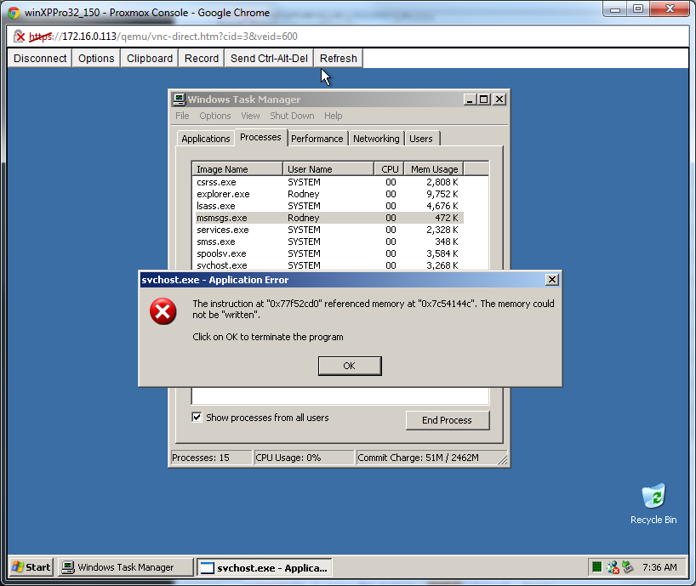
Choosing an Exploit
MS03-026
Exploit Database – 1st version

Slide 28
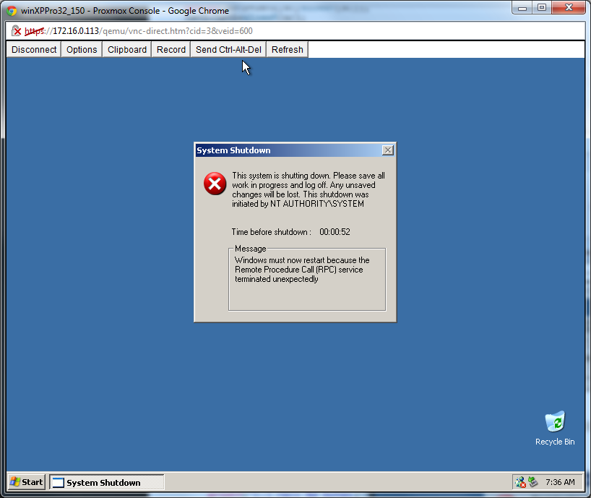

Slide 29
Exploit Maturity
First versions
Tend to be crash
Subsequent versions
More refined
Handle memory addresses
Different versions of OS
Need lots of testing
Virtualization labs help
Fingerprinting helps

Slide 30
Chosen Exploit
Metasploit Framework
Ruby version well developed
Utilizes libraries for RPC
Payload
Remote uploader
Port 65534
Copies larger worm binaries
Copies OS patch
Versus official WUS download

Slide 31
Evaluation
Written in C++
Larger than C/assembly
Smaller than Java
Avoids mistakes of buffer overflow
Benevolent worm can’t create vulnerability
Statically compiled

Slide 32
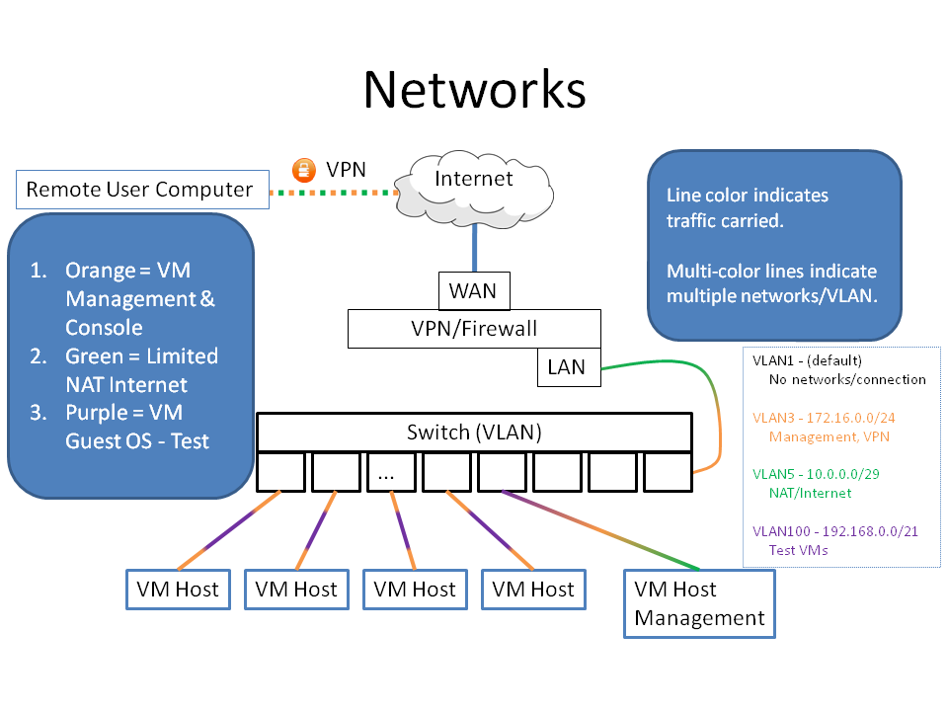
Test Environment
34 VMs – Various Windows OSes
Notes:
PICTURE OF RACK & NETWORK DIAGRAM – 1 bullet at bottom with summary of this info

Slide 33
Execution Flow
Worm Starts
Log Cfg & Options
Patch OS
no
Target List Empty?
yes
Attempt Exploit on next target
no
End
Successful Exploit?
yes
Another copy of worm is running on exploited target

Slide 34
Test Steps
Revert all test VMs
Start worm execution from seed VM
Collect logs
Verify non-vulnerable VMs didn’t crash
Reboot exploited VMs
Finishes OS patch install
Test exploit again
Verify expected number of patched

Slide 35
Results
Table 1: First Iteration
Total Targets (existent and non-existent) | 38
Total Existent Targets | 34
Expected Exploitable | 27
Actual Exploited | 15
Expected Patched by Worm | 26
Actual Patched by Worm | 15
Expected Unaffected | 7
Actual Unaffected | 19
Actual Crash | 0
Run Time (min:sec) | 15:14
About 45% not exploited
Responsiveness of target

Slide 36
Results – Iteration 3
Table 3: Third Iteration
Total Targets (existent and non-existent) | 38
Total Existent Targets | 34
Expected Exploitable | 27
Actual Exploited | 13
Expected Patched by Worm | 26
Actual Patched by Worm | 12
Expected Unaffected | 7
Actual Unaffected | 21
Actual Crash | 0
Run Time (min:sec) | 13:48
Similar to iterations 1 & 2

Slide 37
Results – Network Congestion
Most Bytes Transmitted
In one instance
2,811,634
Bulk in worm & OS patch
100mbps switch
22.5% of bandwidth between 2 nodes
About 1 second
No significant impact

Slide 38
Results – Network Congestion (cont)
10mbps link
2.25 seconds to send
More significant impact
Exponential spread
Multiple 48-port 100mbps switches
1 gigabit / second channel
Congestion at 40+ sending nodes
Example on next slide

Slide 39
Results – Exponential Congestion
Single 48-port switch spread
1 -> 2
2 -> 4
4 -> 8
… … … …
8 -> 16
…
16 -> 32
Assume all local until 16 -> 32 with 32 on other switch

Slide 40
Results - Exponential Congestion (cont)
Switch # 1
Targeting 32 nodes on Switch # 3
1 gbps link
Switch # 2
Targeting 32 nodes on Switch # 4
Congestion occurs here
1 gbps link
Switch # 3
Targeting nothing currently
1 gbps link
Switch # 4
Targeting nothing currently

Slide 41
Concluding Remarks
Benevolent worm feasible? = YES
Auditable (log)
Resource control (network)
Still has risks
Crashes
Legal precedent
Benefits
Safer Internet

Slide 42
Future Work
Log authenticity
Replication
Redundancy
Hybrid linear/exponential
What fan-out is useful?
UI research
Help users versus scare
Scaring could be beneficial

Slide 43
References
Please see thesis paper: “A Framework for Benevolent Computer Worms” by Rodney Beede, 2012
Clipart provided in part by http://openclipart.org
PowerPoint theme provided by Office 2007
Modified by Rodney Beede

Slide 44
Extra Material
The following slides are extra material for the presentation
Time allowing
Questions relevant

Slide 45
Auditable – Log Format
Standardized time stamp
ISO 8601:2004
UTC
Avoids DST & time zone issues
YYYY-MM-DDThh:mm:ss,fffZ
2012-02-20T14:51:22,98Z
UTF8
Supports non-English systems
<ISO 8601 timestamp><single tab><message><carriage return><new line>
Notes:
BACKUP SLIDE

Slide 46
Other Considerations
CPU
Lower priority to process
Worm may be too slow, that’s okay
Memory
Terminate if low
Disk
Sufficient for log & worm
Notes:
BACKUP SLIDE

